Slide 1
Public Administration Research in Brazil
A comparative perspective
Alketa Peci
EBAPE/FGV
Revista de Administração Pública

Slide 2
Topics of discussion
The role of associations and governmental regulation in PA research;
Brazilian PA research from a comparative perspective;
Cognitive dimensions;
Methodological strategies;
Institutional characteristics and scholar’s distribution.

Slide 3
Associations and Governmental Regulations
Association of graduate programs of administration and public administration - ANPAD;
Individual researchers also participate in the Divisions – electing the team of coordinators.
Historically, ANPAD has been an important player for institutionalization of PA as an academic field within broader management research;
Growing governmental regulation (Capes/CNPq) for quality insurance – rankings of programs, researchers, and journals, distribution of scholarships, and grants.

Slide 4
PA research in Brazil: A comparative perspective
Content analysis to 592 Brazilian publications in order to assess the cognitive orientations, methodological strategies, and institutional aspects of PA in Brazil;
Comparison of these results with previous evaluations of North American PA publications.

Slide 5
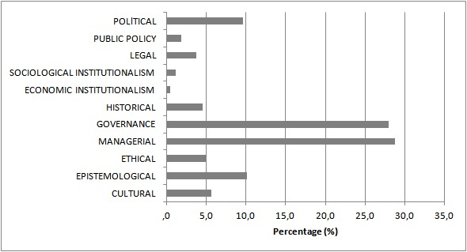
Cognitive orientations

Slide 6
Keywords – themes

Slide 7
Methodological strategies
Dominance of case studies, qualitative and quantitative surveys

Slide 8
Methodological strategies
Data collection versus data analysis

Slide 9
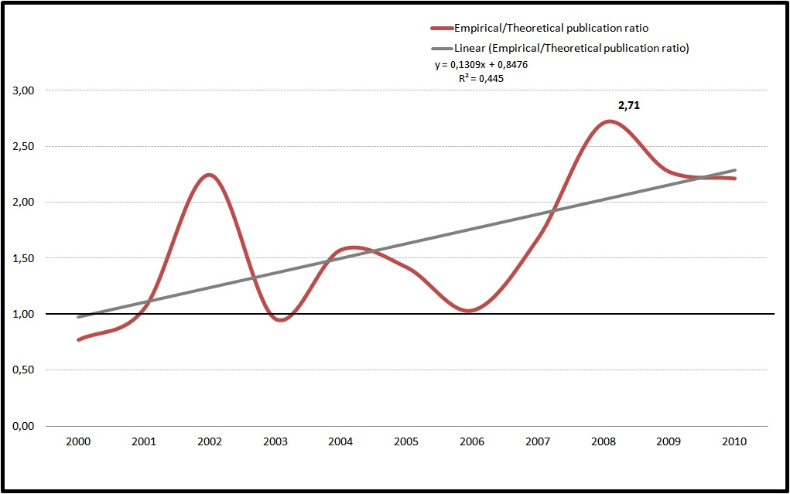
Methodological strategies
General trends: growing nr of empirical studies

Slide 10
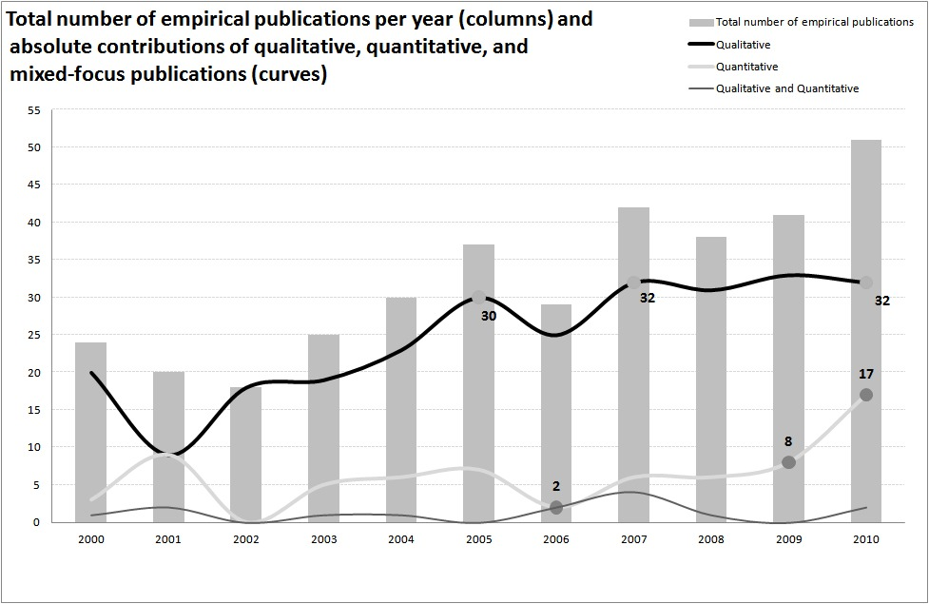
Methodological strategies
General trends: growing nr of quantitative research in recent years

Slide 11
Institutional dimensions

Slide 12
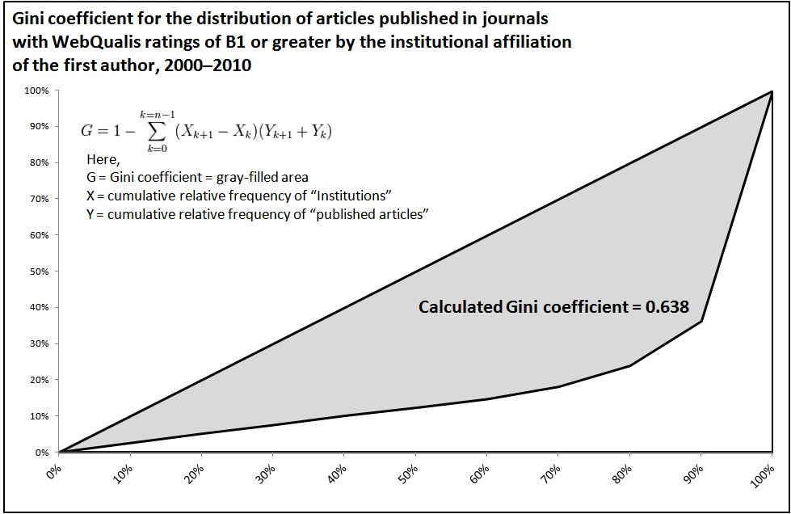
Institutional dimensions: scarcity and inequality

Slide 13
Trends
Rhetorical analysis: growing “academization” – different from other strategies of legitimation (being scientific, being relevant to the practitioners, being different, etc.);
the role of the institutional foundations of the field in PA research (North American “gigantism” and its microscopic research, comprehensible to a small group of experts);
the growing circularities of ideas, translated in similar trends of cognitive trends, related to managerialism with its renamed “POSDCORB” categories;
Mimetic trends in some methodological dimensions of PA research
- Does such intellectual diffusion follows a central (developed country) to peripheral (developing country) direction? Is there a Brazilian “particularism”?

Slide 14
Leading themes and learning opportunities
Public-private partnerships, third-party and collaborative governance, contracting, contract management and performance – but how State-centered differ from market-centered contexts in adapting/reacting/transforming these governance instruments?
Race, gender and representative bureaucracy in the context of Weberian states;
Political and organizational leadership, transformational leadership, public values and public service motivation – neglected issues in Brazilian PA research;
Administrative data, benchmarking programs – conditional cash programs: administrative burdens versus bureaucratic learning.

